Slide 1
EIRSAT-1 ADCS
(Attitude Determination and Control System)
Daire Sherwin, Joseph Thompson, Victorio Ubeda
01/09/2017
The EIRSAT-1 project is carried out with the support of the Education Office of the European Space Agency, under the educational Fly your Satellite! Programme

Slide 2
Introduction
Model
Theory
Simulink
Results
Hardware
%% Not to sure about this slide %%

Slide 3
ADCS Simulations. Software
%% Beginning of presentation %%
MATLAB / Simulink
Highly standardized in control engineering
MATLAB integrates well with other simulation software
Can generate C / C++ code
Level-2 S functions
Allow the integration of custom Matlab code into Simulink
Pros | Cons
Readily installed math libraries and toolboxes | ‘Black box’ compared to other programming languages

Slide 4
ADCS Simulations. Software
MATLAB / Simulink
Highly standardized in control engineering
MATLAB integrates well with other simulation software
Can generate C / C++ code
Level-2 S functions
Allow the integration of custom Matlab code into Simulink
Pros | Cons
Readily installed math libraries and toolboxes | ‘Black box’ compared to other programming languages

Slide 5
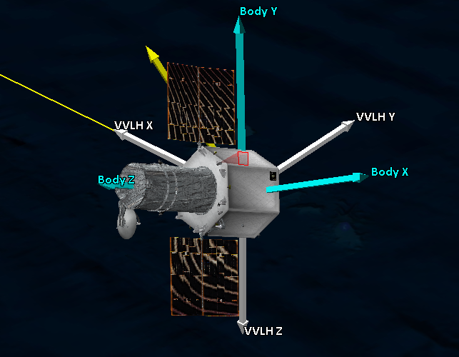
ATTITUDE

Slide 6
CONTROL
Reference
Control
Dynamics

Slide 7
ATTITUDE CONTROL
Disturbances
+
Dynamics
Environment
+
Actuator
Control
Reference
Mode selection
Sensors
Ground Segment

Slide 8
ATTITUDE CONTROL
Disturbances
+
Dynamics
Environment
+
Actuator
Control
Reference
Mode selection
Sensors
Ground Segment

Slide 9
SENSORS
Disturbances
+
Dynamics
Environment
+
Actuator
Control
Reference
Mode selection
Sensors
Ground Segment

Slide 10
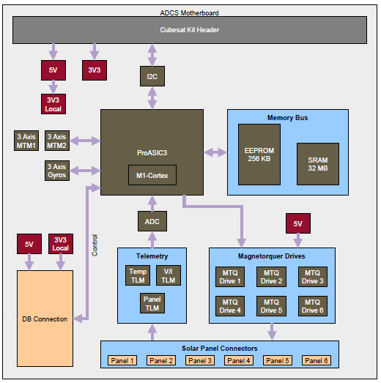
SENSORS
Clyde Space ADCS Board
Magnetometer
IMU
GPS
Coarse Sun Sensor
Dynamic response
Delay
Noise
Uncertainty
State Estimation.
Kalman filters

Slide 11
SENSORS
Disturbances
+
Dynamics
Environment
+
Actuator
Control
Reference
Mode selection
Sensors
Ground Segment

Slide 12
Mode selection
Detumbling
Zenith / Nadir Pointing
Sun pointing (Inertial reference)
Animation Sun Pointing
Animation Zenith Pointing

Slide 13
Environment. Magnetic field
Spherical harmonics approximation
International geomagnetic reference (IGRF), provided by International
Currently 12th generation
Plots

Slide 14
Environment. Magnetic field
Spherical harmonics approximation
International geomagnetic reference (IGRF), provided by International
Currently 12th generation
Plots

Slide 15
ADCS Model
Disturbances
+
Dynamics
Environment
+
Actuator
Control
Reference
Mode selection
Sensors
Ground Segment

Slide 16
ADCS Model
Disturbances
+
Dynamics
Orbital Dynamics
Rotational dynamics
Environment
+
Actuator
Control
WBC
Reference
Mode selection
Sensors
Ground Segment

Slide 17
ADCS Model
Disturbances
Aerodynamic drag
Gravity gradient
Solar radiation
Internal magnetic Dipole
+
Dynamics
Orbital Dynamics
Rotational dynamics
Environment
Magnetic Field
(IGRF. Spherical harmonics)
+
Actuator
MagneticTorquers
Control
PID
LQR
WBC
Reference
Desired
Attitude
Mode selection
Detumbling
Zenith pointing
Sun pointing
Sensors
Delay
Noise
Errors
Ground Segment

Slide 18
ADCS Model
Disturbances
Aerodynamic drag
Gravity gradient
Solar radiation
Internal magnetic Dipole
+
Dynamics
Orbital Dynamics
Rotational dynamics
Environment
Magnetic Field
(IGRF. Spherical harmonics)
+
Actuator
MagneticTorquers
Control
PID
LQR
WBC
Reference
Desired
Attitude
Mode selection
Detumbling
Zenith pointing
Sun pointing
Sensors
Delay
Noise
Errors
Ground Segment

Slide 19
%% Questions? %%
Is the choice of this structure clear?
Why this particular arrangement?

Slide 20
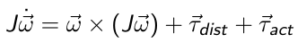
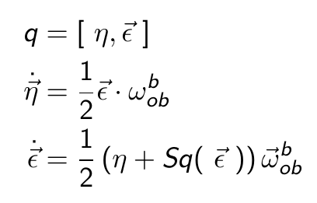
Dynamics
Rotational Dynamics and Kinematics
Dynamics.
Euler Equations
Kinematics
Quaternions
Euler angles / Roll – Pitch – Yaw may produce singularities when calculating Rotation Matrix
%% ... But not time %%
%% Choice of C.S. %%
%% 3D rotations complicated because…
%% Hamilton solved this…

Slide 21
Dynamics
Rotational Dynamics and Kinematics
Dynamics.
Kinematics
Quaternions
Euler angles / Roll – Pitch – Yaw may produce singularities when calculating Rotation Matrix
Orbital Dynamics
No need for precision in position
Assumed circular orbit
Constant orbit angular velocity
Specified Argument of Periapsis and True Anomaly
Argument of periapsis and true anomaly

Slide 22
Orbital Dynamics
Orbital Dynamics
Short time Scale
No need for precision in position
Assumed circular orbit
Constant orbit angular velocity
Specified Argument of Periapsis and True Anomaly
%% What I mean with this is that we do not
simulate translation accurately %%
%% Diagram %%

Slide 23
Reference
Two reference quaternions
Zenith / Nadir Pointing
Sun Pointing (Inertial reference frame)
Reference frames

Slide 24
Wave – Based Control
Launch a Wave
Absorb the returning wave
Reject disturbances
%% WBC was developed originally at UCD by Dr William J. Oconnor %%

Slide 25
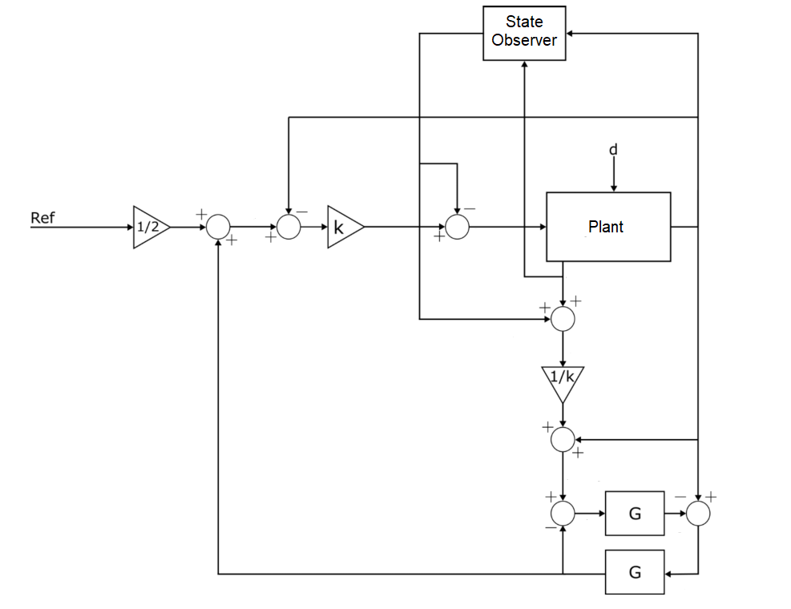
Wave – Based Control
Launch a Wave
Absorb the returning wave
Reject disturbances

Slide 26
Wave – Based Control
Developed originally at UCD by Dr. William J. O’connor
No model needed
Robust to system changes
Robust to actuator limitations
Stable, fast, smooth
Computationally light

Slide 27
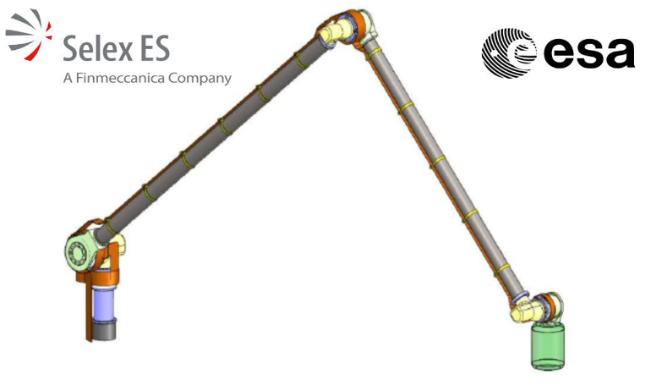
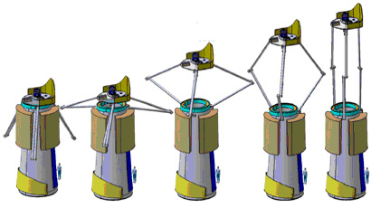
Wave – Based Control
Two ESA contracts
Delian Arm
IXO

Slide 28
Disturbances
Gravity gradient
Neglectable for CubeSat size
Solar radiation pressure
Aerodynamic drag %% The biggest (?) one %%
Internal magnetic Dipole %% The biggest (?) one %%
%% Ussually, 4 tipes of disturbances are considered,
but for EIRSAT, two of them are much greater
than the others %%
Plot
Plot

Slide 29
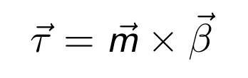
Actuators. Magnetorquers
Magnetic torquers
No inverse for vector product
Pseudo – inverse
SR – inverse
Projection of the control troque
Scenarios
Three ideal actuators
Three magnetorquers
Two magnetorquers
One magnetorquer
%% Magnetic field, normal plane,
control torque, dipole,
actuator torque %%

Slide 30
Solver
%% Add some more %%
Runge Kutta 4 / 6
Variable step
Handled automatically by Simulink

Slide 31
Solver
Runge Kutta 4 / 6
Variable step
Handled automatically by Simulink

Slide 32
Limitations and Improvements
Standardized coordinate systems and reference frames
SPICE
Full documentation
In process
Third – Body Forces
Sun reference

Slide 33
Hardware. Clyde Space Board
%% Technical specifications from manual %%

Slide 34
Hardware. Clyde Space Board
%% Technical specifications from manual %%

Slide 35
Documentation

Slide 36
References

